Slide 1


ZOIDBERG 2.0
AI classification project

Slide 2
SUMMARY
Team
Organization
Project
Demonstration
Conclusion

Slide 3


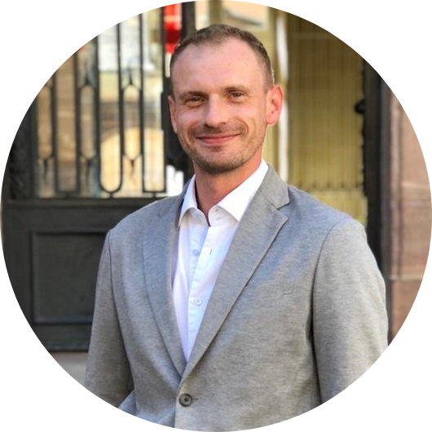


Team
Pierre Bobard
AI Engineer
Strasbourg
Johan-David Dehi
AI Engineer
Paris
Gregory Koenig
AI Engineer
Strasbourg
Richard La
AI Engineer
Strasbourg
Maxime Lardier
AI Engineer
Strasbourg

Slide 4
ORGANIZATION - SHARING -
Project organization
Team objectives
Individual objectives

Slide 5


Organization - Communication -

Slide 6








Project - Technologies -
Tools
Technical stack
Environments

Slide 7
Project – Main Concepts –
Creating and preparing the datasets
Model initialization
Model training
Model modification and optimization
Model validation

Slide 8
Project – Main Concepts –
Evaluation and prediction through the final model
Results and visual presentation

Slide 9
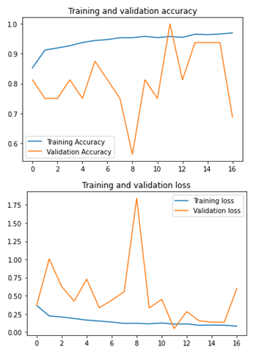

Slide 10
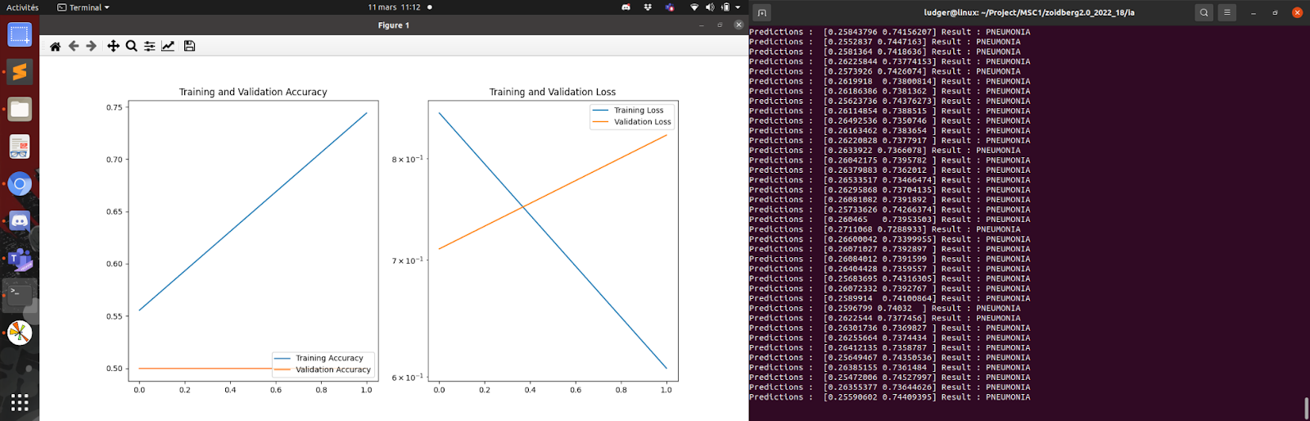

Slide 11
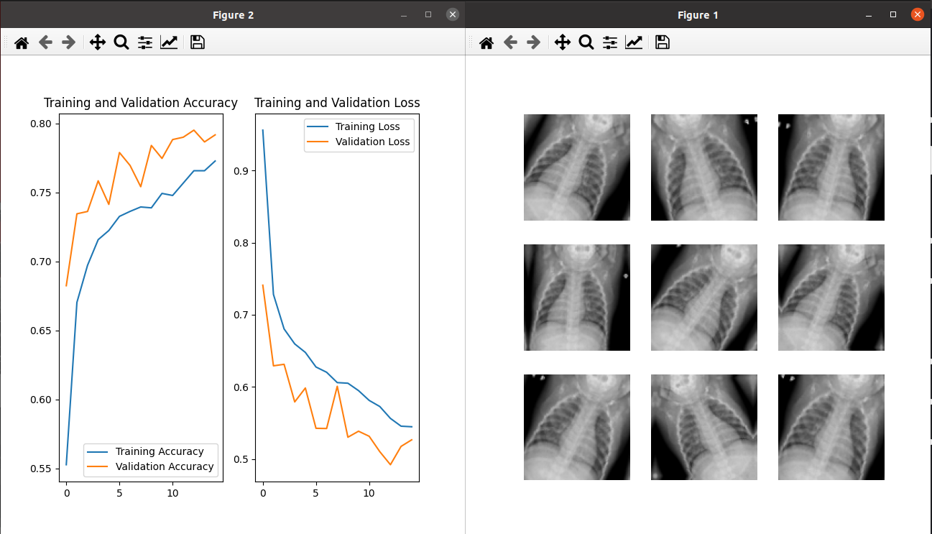

Slide 12

Demonstration

Slide 13
Conclusion
Visualization
Results
Feedback

Slide 14

Questions

Slide 15

Thank you for your attention

